Slide 1
Language Models

Slide 2
Language Models
designed to understand, generate, and predict human language
analyze the structure and use of language to perform tasks such as machine translation, text generation, and sentiment analysis.
statistical or machine learning model that is used to predict the next word in a sequence given the previous words.

Slide 3
Types
Pure Statistical Methods
Neural Models

Slide 4
Pure statistical methods
form the basis of traditional language models.
rely on the statistical properties of language to predict the next word in a sentence, given the previous words.
n-grams, exponential models, and skip-gram models

Slide 5
n-gram
sequence of n items from a sample of text or speech, such as phonemes, syllables, letters, words, or base pairs
frequency of sequences in a training corpus to predict the likelihood of word sequences.
N-gram models are simple, easy to implement, and computationally efficient, making them suitable for applications with limited computational resources.

Slide 6
n-gram example
Eg: “I love NLP . NLP is fun . I love fun .”
Tokens (in order):
["I", "love", "NLP", ".", "NLP", "is", "fun", ".", "I", "love", "fun", "."]
Total tokens
N=12
Unique tokens (vocabulary)
V=6 I, love, NLP, is, fun, .

Slide 7
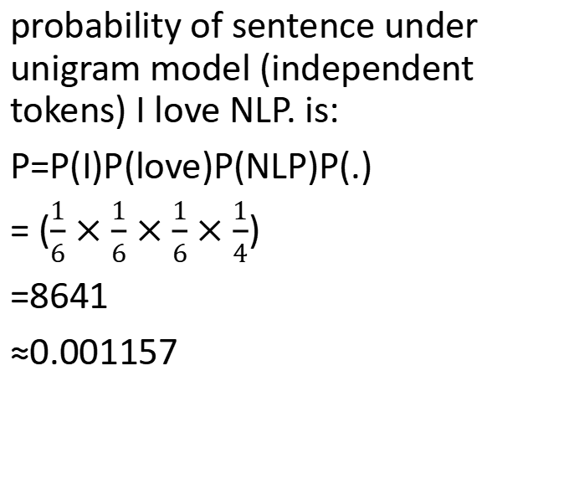
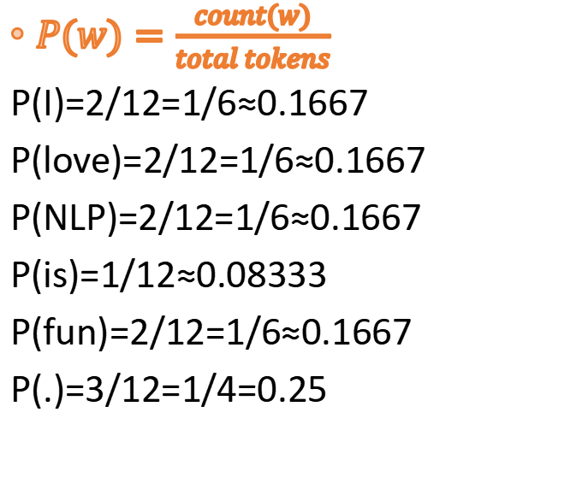
Unigram
$P(w)=\frac{count(w)}{total tokens}$
P(I)=2/12=1/6≈0.1667
P(love)=2/12=1/6≈0.1667
P(NLP)=2/12=1/6≈0.1667
P(is)=1/12≈0.08333
P(fun)=2/12=1/6≈0.1667
P(.)=3/12=1/4=0.25
probability of sentence under unigram model (independent tokens) I love NLP. is:
P=P(I)P(love)P(NLP)P(.)
= ($\frac{1}{6}$ $×\frac{1}{6}×\frac{1}{6}×\frac{1}{4}$)
=8641​
≈0.001157

Slide 8
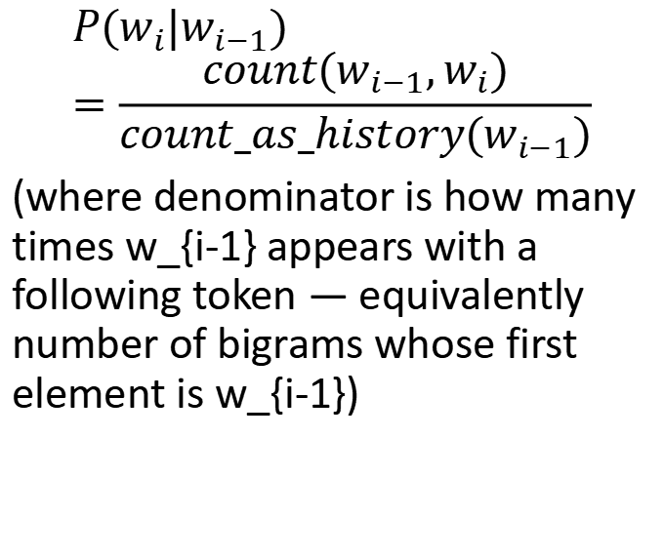
Bigram model
(I, love) = 2
(love, NLP) = 1
(love, fun) = 1
(NLP, .) = 1
(NLP, is) = 1
(., NLP) = 1
(is, fun) = 1
(fun, .) = 2
(., I) = 1
$$P(w_{i}|w_{i−1})=\frac{count(w_{i−1},w_{i})}{count_as_history(w_{i−1})}$$
(where denominator is how many times w_{i-1} appears with a following token — equivalently number of bigrams whose first element is w_{i-1})

Slide 9
Bigram model
Denominators (as first element of a bigram):
I as first: 2 → (I,love)=2 so count(I)=2
love as first: 2 → (love,NLP)=1, (love,fun)=1 so count(love)=2
NLP as first: 2 → (NLP,.)=1, (NLP,is)=1 so count(NLP)=2
. as first (only when it has next token): 2 → (.,NLP)=1,(.,I)=1
is as first: 1 → (is,fun)=1
fun as first: 2 → (fun,.)=2

Slide 10
Bigram
Denominators (as first element of a bigram):
I as first: 2 → (I,love)=2 so count(I)=2
love as first: 2 → (love,NLP)=1, (love,fun)=1 so count(love)=2
NLP as first: 2 → (NLP,.)=1, (NLP,is)=1 so count(NLP)=2
. as first (only when it has next token): 2 → (.,NLP)=1,(.,I)=1
is as first: 1 → (is,fun)=1
fun as first: 2 → (fun,.)=2
Bigram probabilities (selected):
P(love|I)
=count(I,love)​/count(I)
=2/2
=1.0

Slide 11
Bigram
P(NLP∣love)=1/2=0.5
P(fun∣love)=1/2=0.5
P(.∣NLP)=1/2=0.5
P(is∣NLP)=1/2=0.5
P(NLP∣.)=1/2=0.5

Slide 12
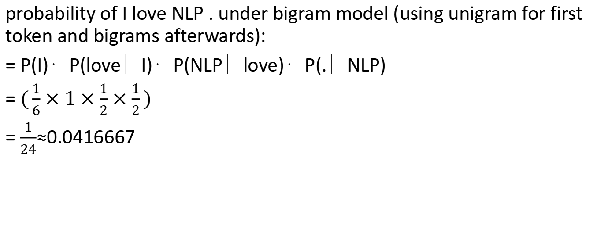
probability of I love NLP . under bigram model (using unigram for first token and bigrams afterwards):
= P(I)⋅P(love∣I)⋅P(NLP∣love)⋅P(.∣NLP)
= $(\frac{1}{6}×1×\frac{1}{2}×\frac{1}{2})$
= $\frac{1}{24}$≈0.0416667

Slide 13
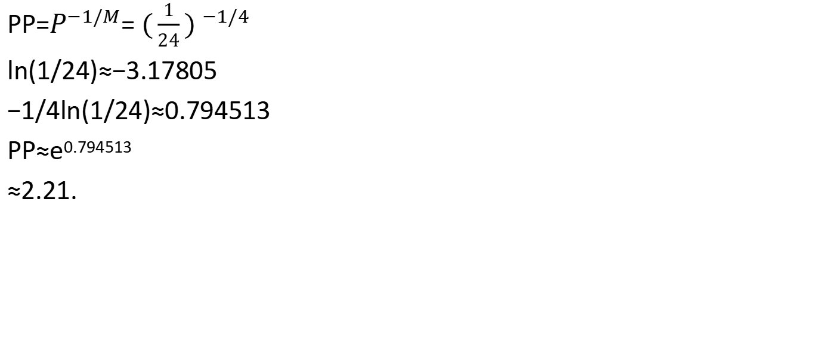
Perplexity of that sentence under bigram (sentence length M=4)
PP=$P^{−1/M}$= ${(\frac{1}{24}) }^{−1/4}$
ln(1/24)≈−3.17805
−1/4ln(1/24)≈0.794513
PP≈e^{0.794513}
≈2.21.

Slide 14
Eg: “I love NLP . NLP is fun . I love fun .”
Test for “ I love NLP . “

Slide 15
Trigram model (example)
(I, love, NLP) = 1
(love, NLP, .) = 1
(NLP, ., NLP) = 1
(., NLP, is) = 1
(NLP, is, fun) = 1
(is, fun, .) = 1
(fun, ., I) = 1
(., I, love) = 1
(I, love, fun) = 1
(love, fun, .) = 1

Slide 16
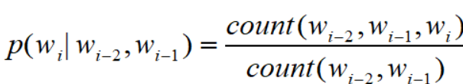
I love occurs twice as history: (I,love,NLP) and (I,love,fun) so count(I,love)=2. Thus conditional trigram probabilities:
P(NLP∣I,love)=1/2=0.5
P(fun∣I,love)=1/2=0.5

Slide 17
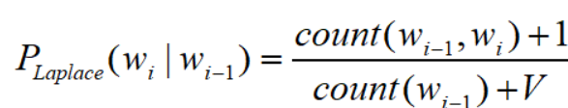
Smoothing (Laplace)
Problem: unseen n-grams have zero probability (and multiply to zero for sentence probability). Add-one smoothing:
P(is|I) = 0+1/count(I)+V =1/(2+6) ​= 1/8 ​= 0.125
P(NLP|love) with Laplace (1+1)/(2+6) = 2/8 ​=0.25

Slide 18
limitations of n-gram
capturing long-range dependencies due to their limited context window.
As n increases, the number of possible n-grams grows exponentially, leading to sparsity issues where many sequences are never observed in the training data.
difficult to accurately estimate the probabilities of less common sequences.

Slide 19
Exponential Models
more flexible and powerful than n-gram models.
assign weights to different features based on the context and combine them using an exponential function to estimate probabilities.

Slide 20
Maximum Entropy (MaxEnt)
estimate the probabilities of different outcomes based on a set of features.
model parameters are learned by maximizing the likelihood of the observed data under the model.
struggle with long-range dependencies because they rely on fixed-length context windows.

Slide 21
Skip-gram models
predict the context words (surrounding words) given a target word within a certain window size.
Word2Vec capture the semantic relationships between words by optimizing the likelihood of context words appearing around a target word.

Slide 22
Word2Vec
developed by Google, includes two main architectures: skip-gram and continuous bag-of-words (CBOW).
The skip-gram model predicts the context words given a target word, while the CBOW model predicts the target word given the context words.
Both models are trained using neural networks, but they are conceptually simple and computationally efficient.

